Slide 1
Text Categorization with Ensemble Methods
Bhavya Gupta & Dr. Alok Kumar
Department of Computer Science and Engineering,
University Institute of Engineering and Technology,
CSJM University, Kanpur

Slide 2
Introduction: Text Classification
Assigning subject categories, topics, or genres
Spam detection
Authorship identification
Age/gender identification
Language Identification
Sentiment analysis
…

Slide 3
Text Classification: definition
Input:
a document d
a fixed set of classes C = {c₁, c₂,…, c_{J}}
Output: a predicted class c ∈ C

Slide 4
Classification Methods: Hand-coded rules
Rules based on combinations of words or other features
spam: black-list-address OR (“dollars” AND“have been selected”)
Accuracy can be high
If rules carefully refined by expert
But building and maintaining these rules is expensive

Slide 5
Classification Methods: Supervised Machine Learning
Input:
a document d
a fixed set of classes C = {c₁, c₂,…, c_{J}}
A training set of m hand-labeled documents (d₁,c₁),....,(d_{m},c_{m})
Output:
a learned classifier f:d → c

Slide 6
Classification Methods: Supervised Machine Learning
Any kind of classifier
Naïve Bayes
Logistic regression
Support-vector machines
k-Nearest Neighbors
…

Slide 7
Objective
Compare the performance of four different text classifiers.
Naïve Bayes, Logistic Regression, Random forest and neural network algorithms.
Use ensemble methods to produce optimal predictive model.
Predictions of each base classifier are combined into one predictive model to decrease the variance.

Slide 8
System Design

Slide 9
Data Preprocessing
Removing all the stopwards
Stemming
Dimension Reduction
TFIDF Vectorizer and Count Vectorizer

Slide 10
Ensemble learning
For improving the accuracy of model, we are gathering results from all the models and deciding the output based on category that comes more times.
In this research, we have used Naïve Bayes, Logistic Regression, Random Forest and Neural Network classifiers to finalize class of a text.

Slide 11
Naïve Bayes
A Naive Bayes classifier is a probabilistic machine learning model that’s used for classification task.
The crux of the classifier is based on the Bayes theorem.
P(A/B) = (P(B/A)P(A))/P(B)
Using Bayes theorem, we can find the probability of A happening, given that B has occurred. Here, B is the evidence and A is the hypothesis.
The assumption made here is that the predictors/features are independent. That is presence of one particular feature does not affect the other. Hence it is called naive.

Slide 12
Logistic Regression
Logistic Regression is a Machine Learning algorithm which is used for classification problems.
It is a predictive analysis algorithm and based on the concept of probability.
Logistic Regression uses a more complex cost function, this cost function can be defined as the ‘Sigmoid function’.
The hypothesis of logistic regression tends it to limit the cost function between 0 and 1.

Slide 13
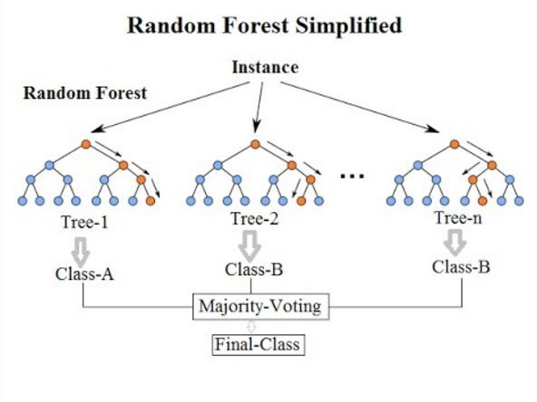
Random Forest
A random forest is a data construct applied to machine learning that develops large numbers of random decision trees analyzing sets of variables.
Random forest classifier creates a set of decision trees from randomly selected subset of training set. It then aggregates the votes from different decision trees to decide the final class of the test object.

Slide 14
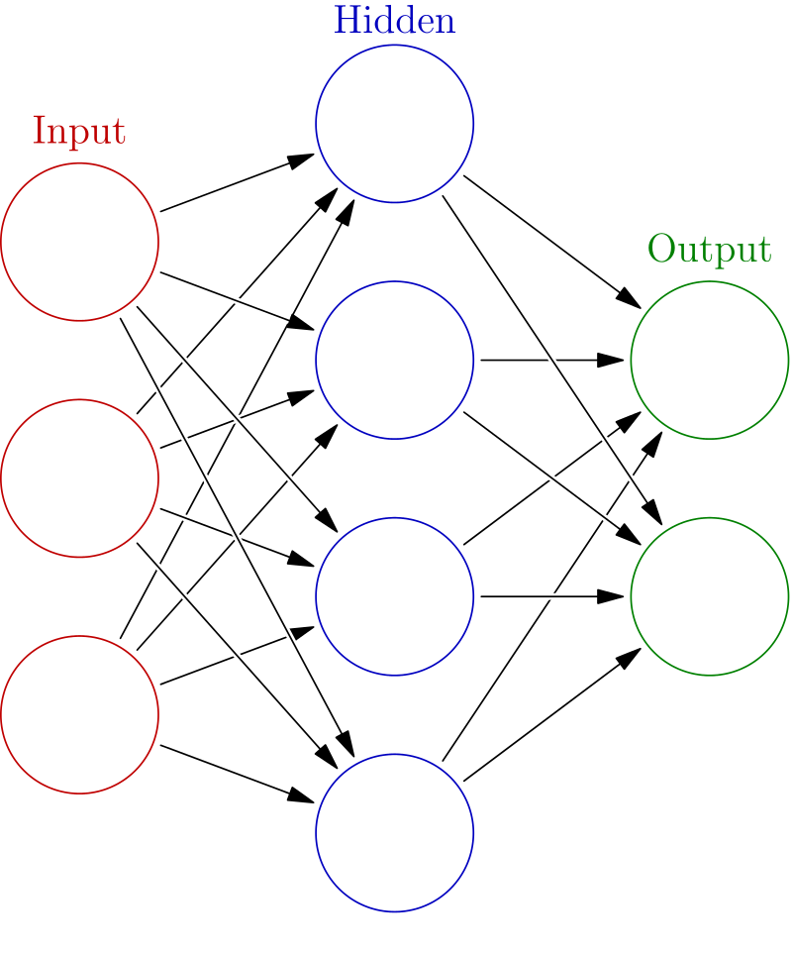
Neural Network
A neural network is a network or circuit of neurons, or in a modern sense, an artificial neural network, composed of artificial neurons or nodes.

Slide 15
Performance Comparison

Slide 16
Conclusion
It has been observed that the supervised learning methods mainly Naïve Bayes (NB), Logistic Regression, Random Forest and Neural Networks are suitable for text classification.
performance of a machine learning system can be enhanced by Ensemble learning

